Slide 1
Ark: sinister

Slide 2
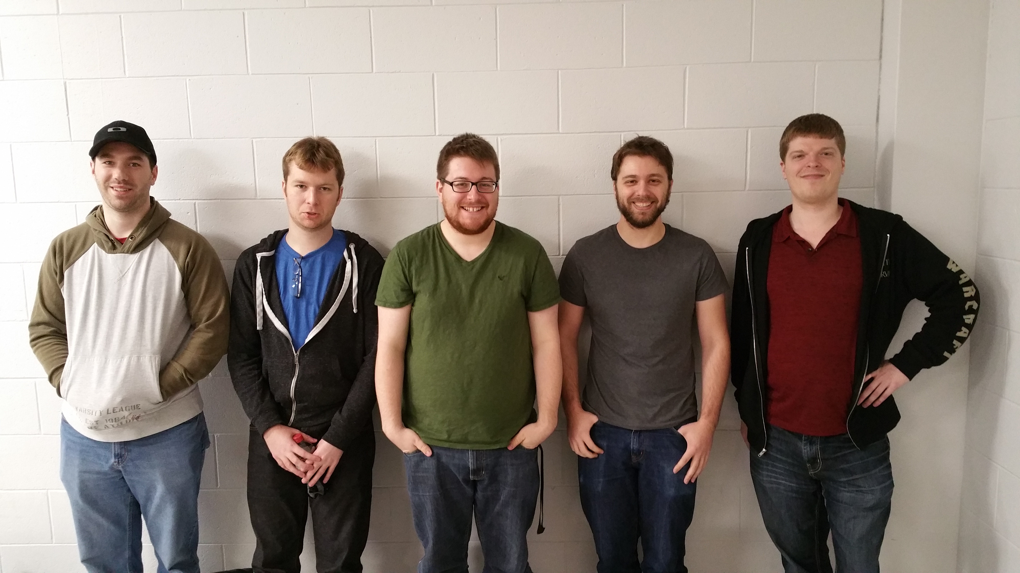
Who are we?
These are our developers.
Chris: Developer
Josh: Developer
Jordan: Developer, Assets
Aaron: Developer, Assets
Kyle: Designer, Developer

Slide 3
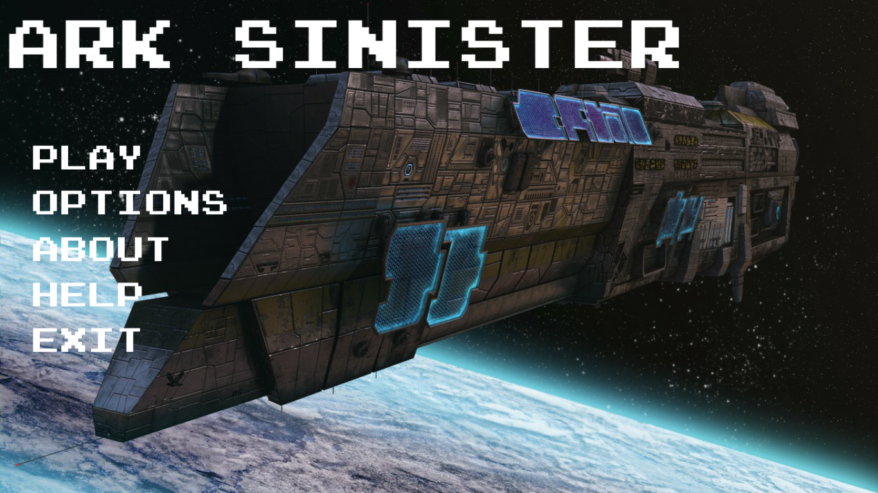
What is ark?
Rogue-Lite in Space!

Slide 4
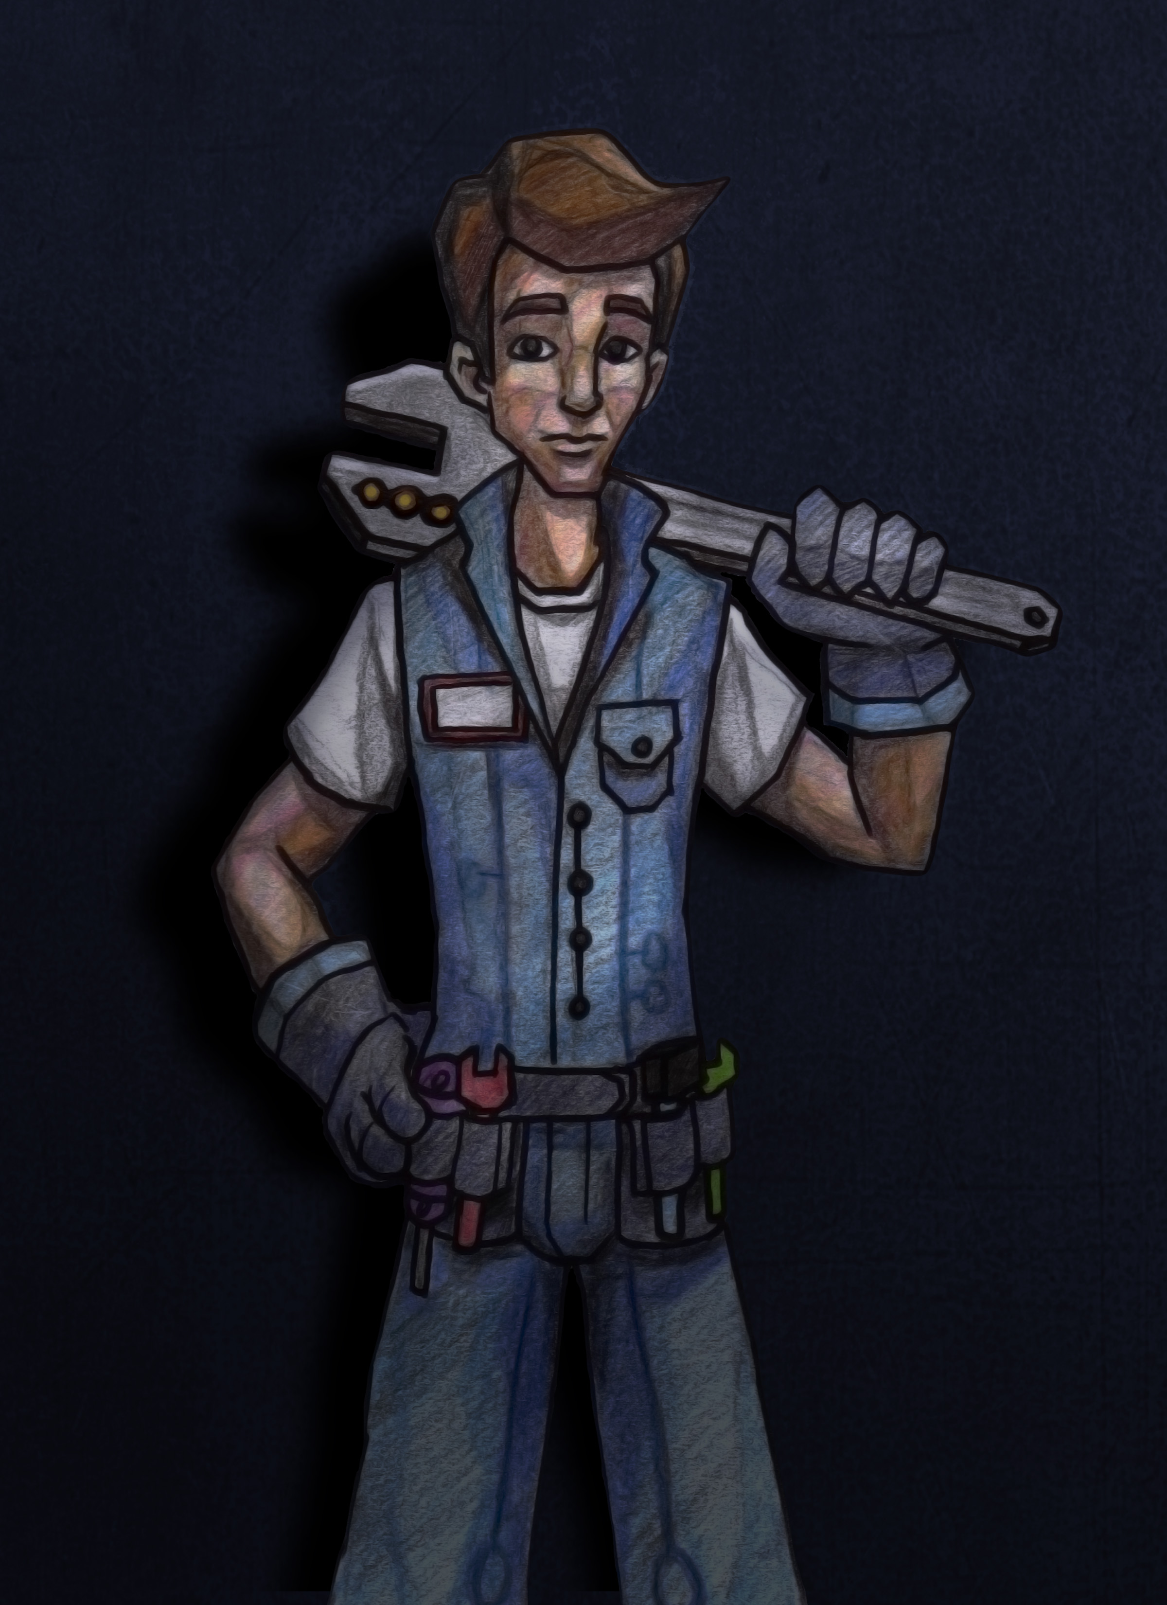
What is ark?
Build the ship as you go! Dozens of room combinations to construct and explore!
Unlockable characters and ship designs as you progress.

Slide 5
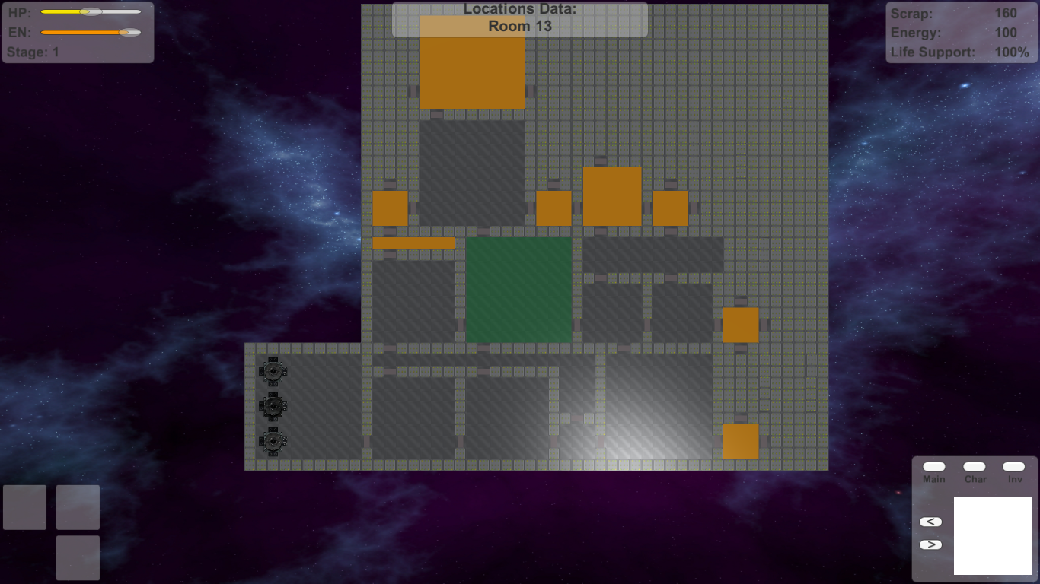
What is ark?
Create unique solutions and strategies to solve problems and game events!
Room events are randomly generated and randomized so no two games will ever be the same!
Discover a deeper mystery going on behind the scenes.

Slide 6
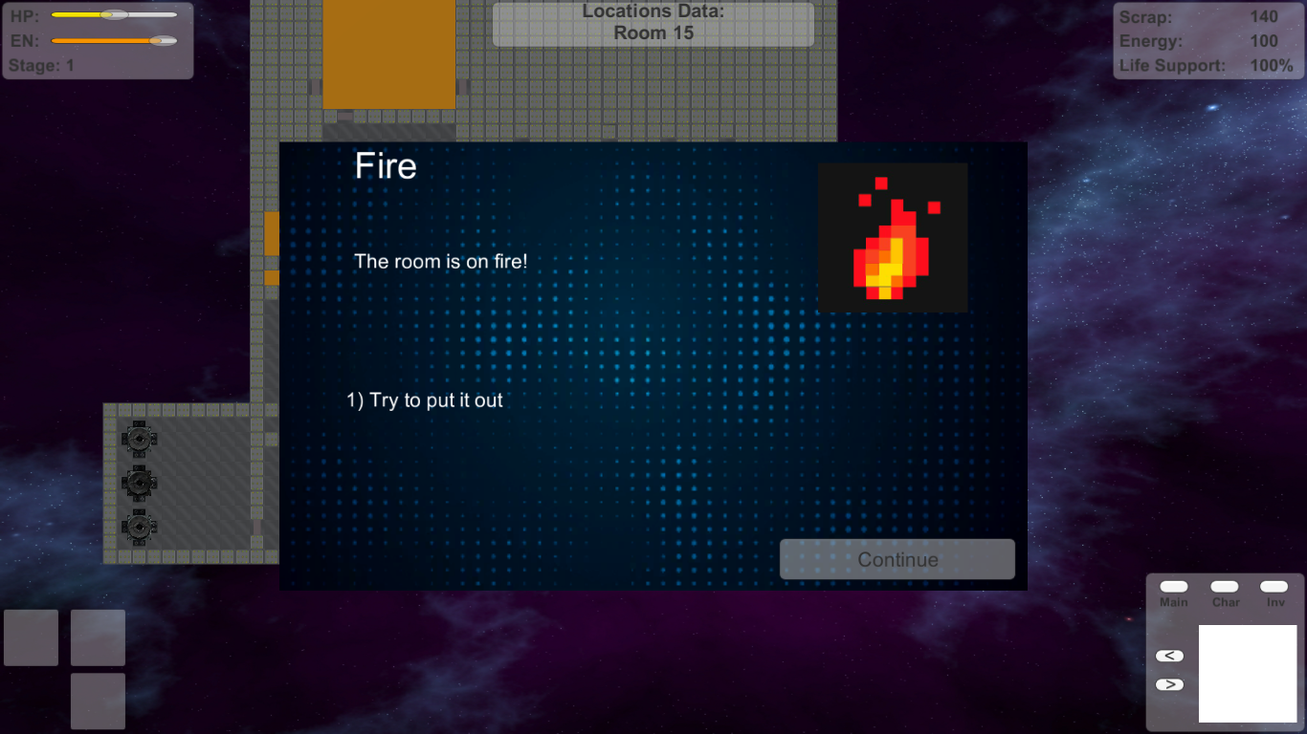
The plan
Have an early access for the end of March.
Content creation / polishing to be finished by April.
Ready for presentation by April 21st, 2016.

Slide 7

How we’re getting this done
Using Unity 5.
Developing assets in Photoshop.
Using the project management tool: Trello
Actively seeking collaborators in graphics design and audio.
Looking at hosting on Kickstarter.

Slide 8
What are the feels?
We’re all gamers.
We want to bring our idea to life.
We all enjoy the strategy involved in managing a game world.
We can bring something unique to the genre.

